Slide 1
Progress Update:
Yelp Reviews vs neighborhood demographic data
Jimmy Moore

Slide 2

City Change
Switched from Pittsburgh to Philadelphia
Desire for more data points (~1500 -> ~12,000)
Philadelphia is a significantly more segregated city
Philadelphia also has a more metropolitan downtown

Slide 3
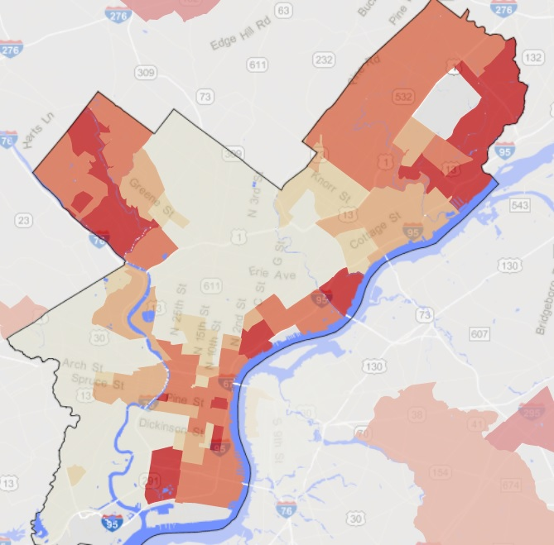
A Segregated City
Philadelphia is very much a city divided by race, due primarily because of Redlining policies of the 1940s and 50s as well as the age of the city.
In this heatmap, the more red an are is, the whiter that area is. It should be noted that at the current moment we are just looking at census data of people who identify as white or not white
Two obvious areas of white flight, as well as a historically white dominated downtown

Slide 4
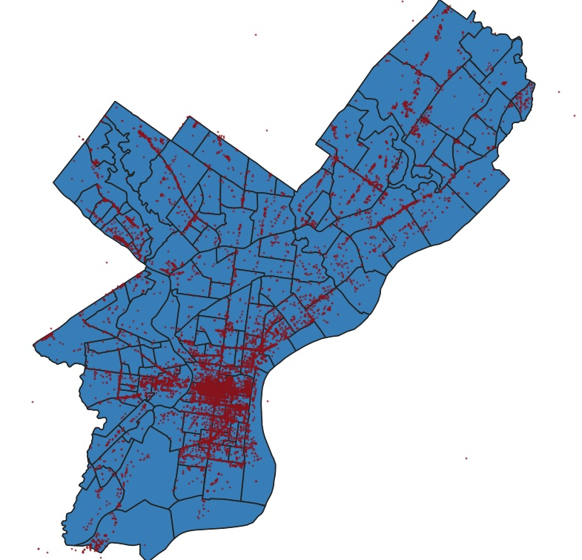
Business Distribution
Each red dot on the blue map is a business that has at least 5 reviews. On the right is the racial heatmap again

Slide 5
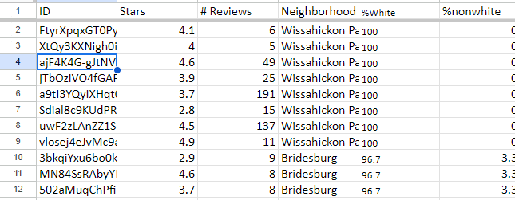
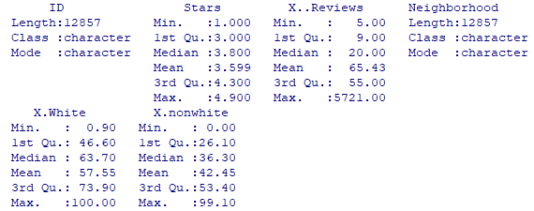
Peeking at the Dataset
A Cursory Glance

Slide 6
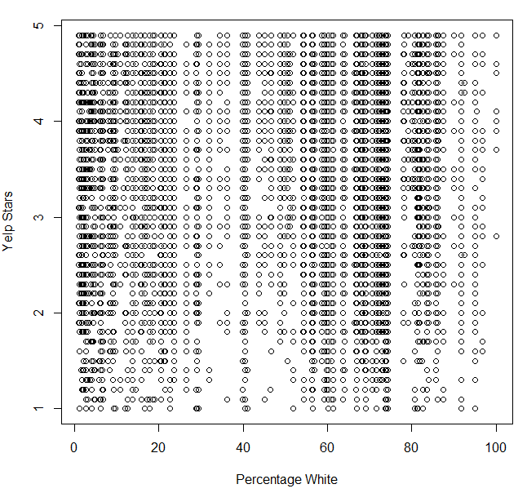
Initial Plotting
No major pattern to the naked eye, other than the segregation is very visible in the thicker areas

Slide 7

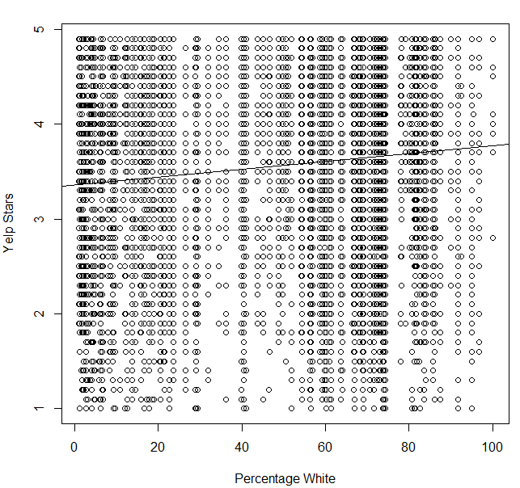
Hidden Patterns
Initial testing, without trimming or clustering shows an immediate trend between the percentage increase of white population and the increase in number of Stars that business receives

Slide 8
Moving Forward & Implications
Grouping Neighborhoods as binary variables and testing significance, this could reconfirm trend or show that there exist outlier neighborhoods
Test neighborhood averages against the trend, attempt to eliminate outliers in that way
This is by no means definitive of correlation, there is still a great amount of noise within the data
Implications ethically and professionally

